Slide 1
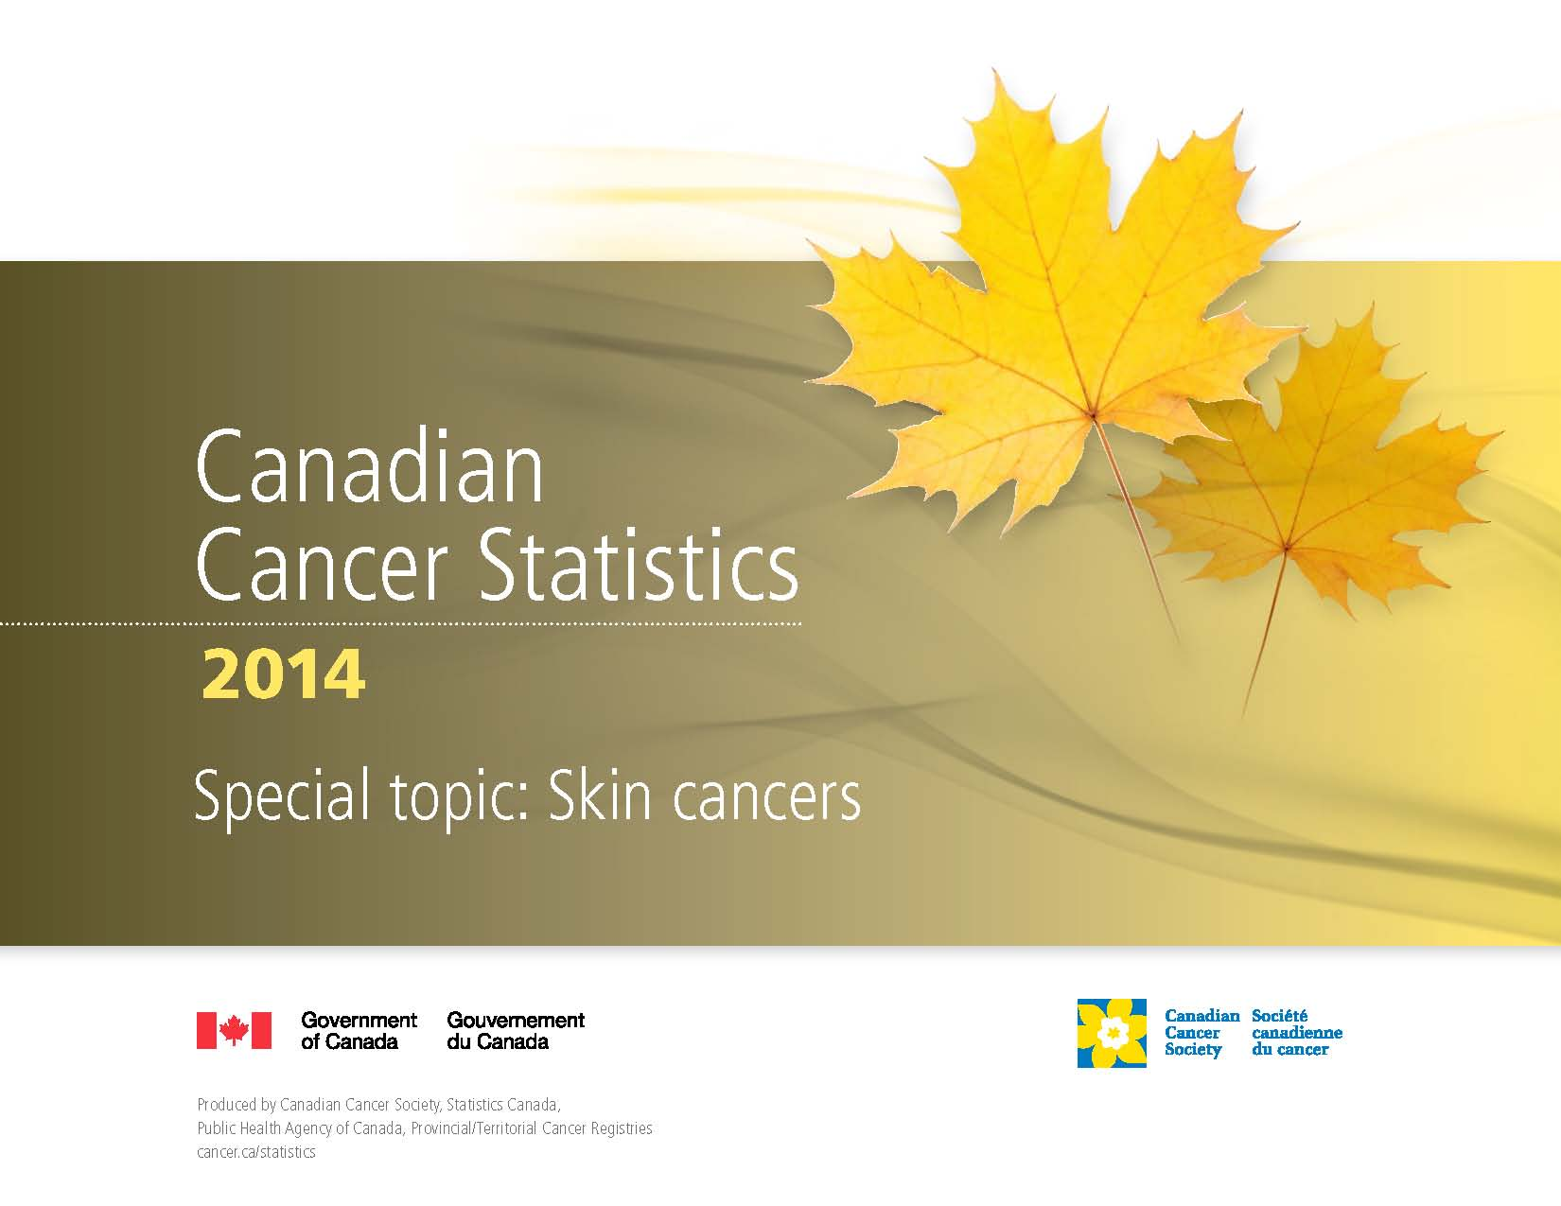

Slide 2
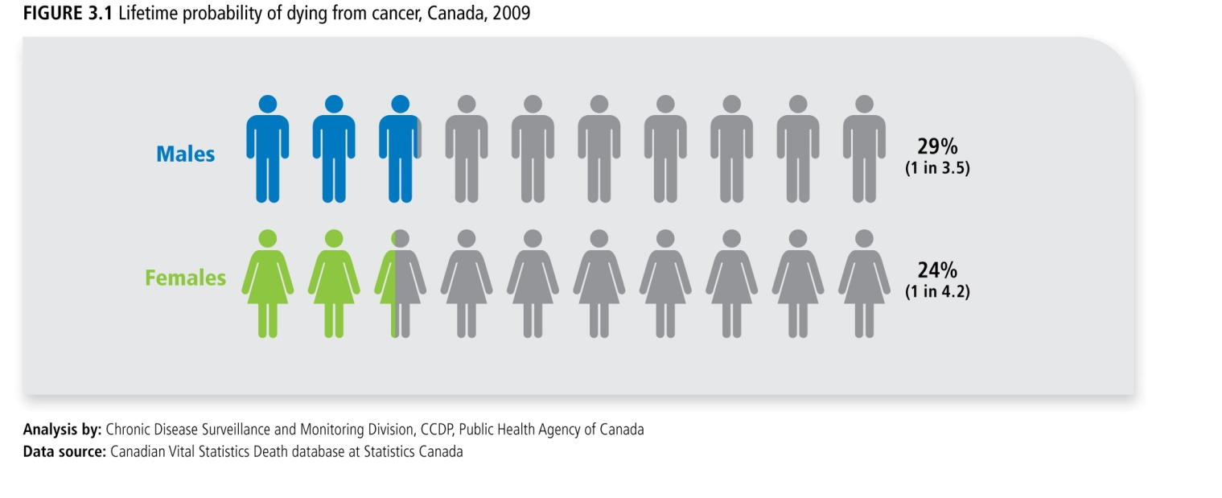
Canadian Cancer Statistics 2014

Slide 3
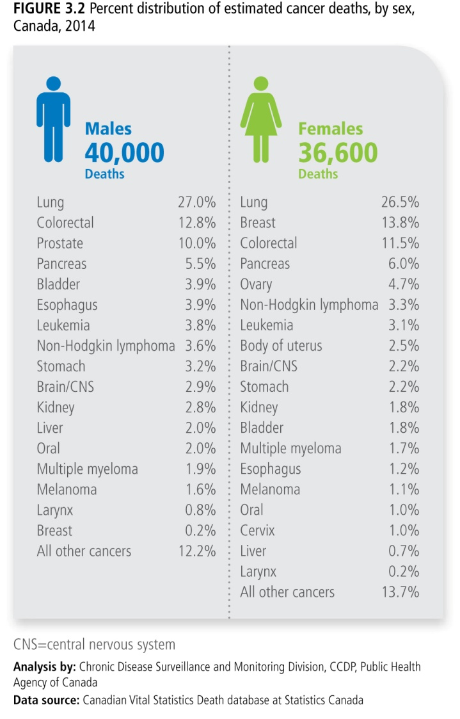
Canadian Cancer Statistics 2014

Slide 4
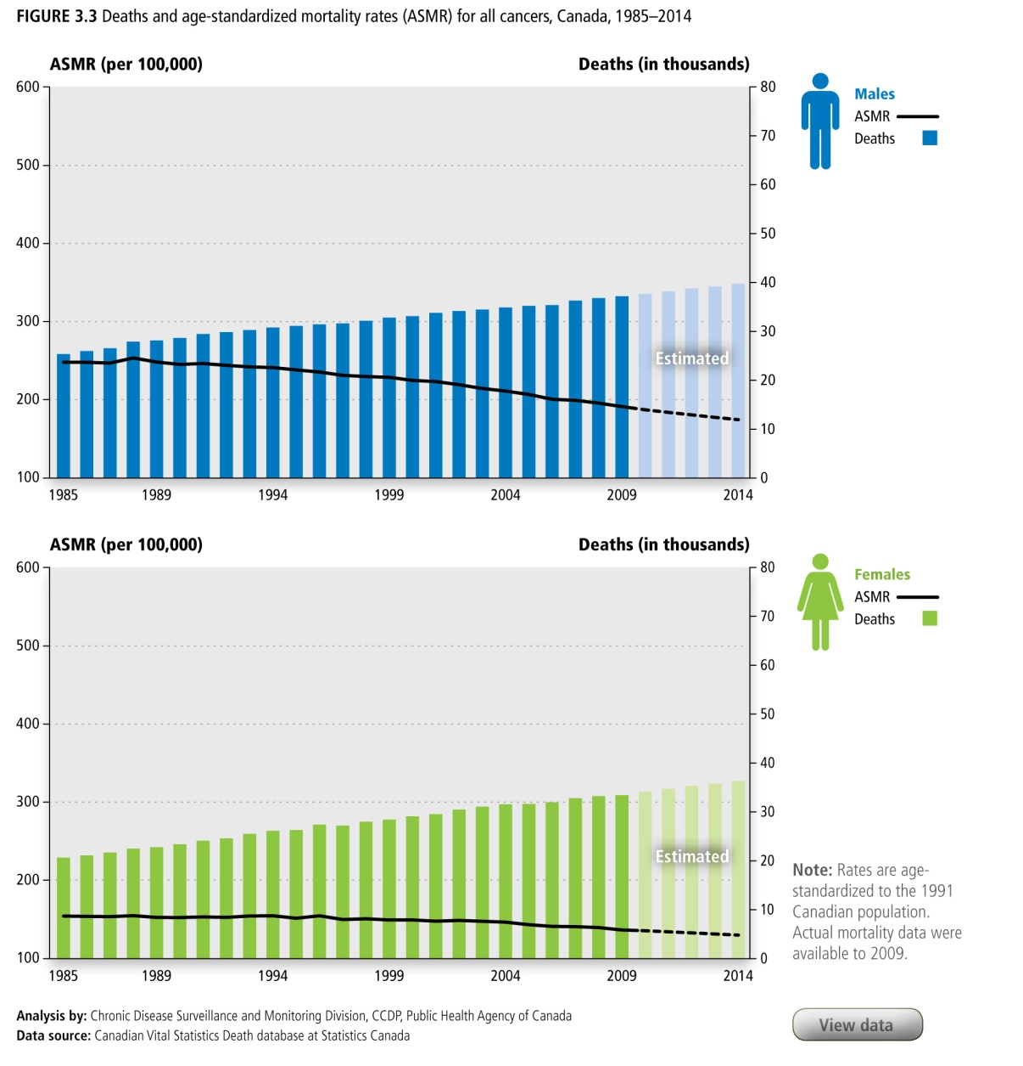
Canadian Cancer Statistics 2014

Slide 5
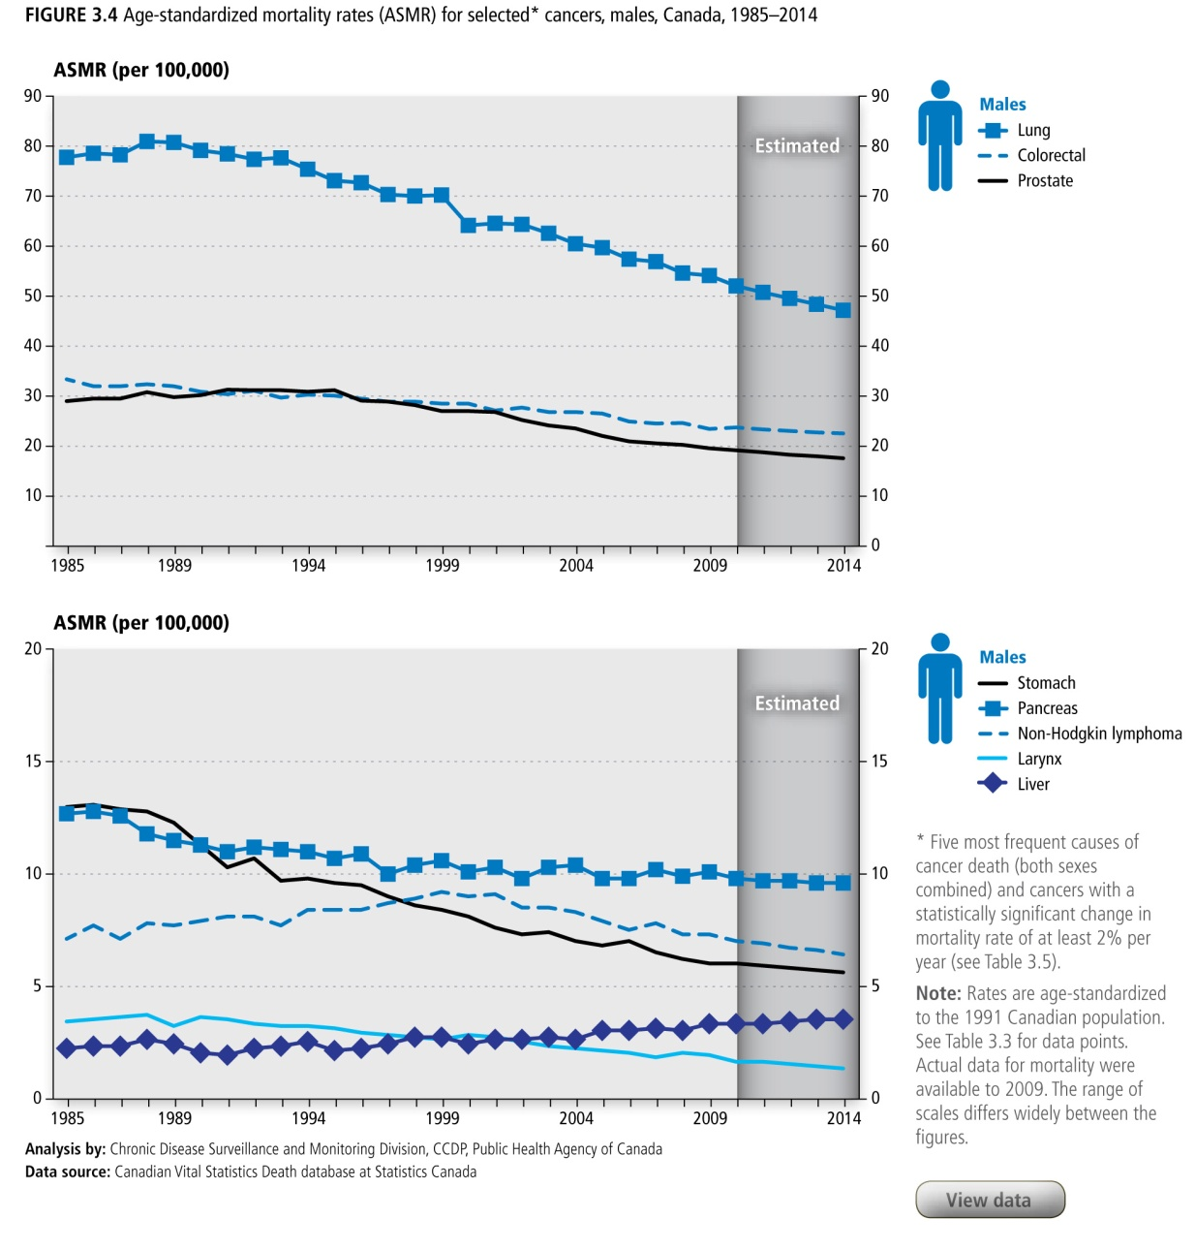
Canadian Cancer Statistics 2014

Slide 6
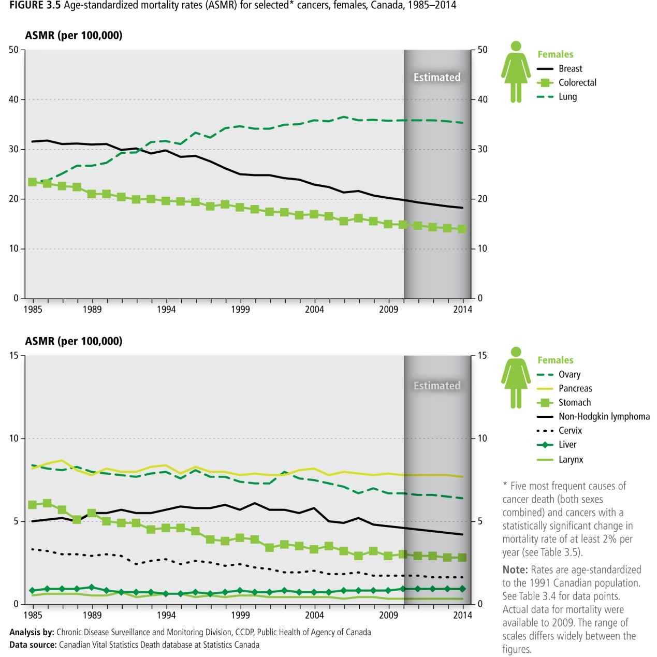
Canadian Cancer Statistics 2014

Slide 7
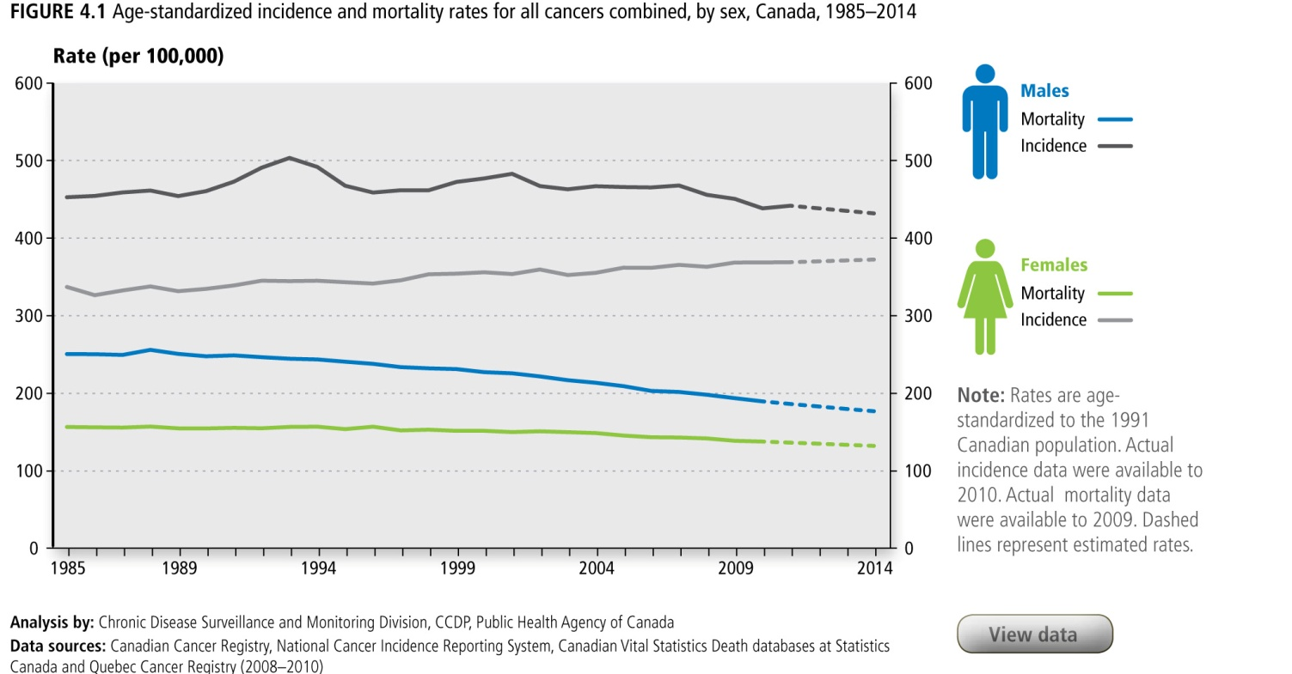
Canadian Cancer Statistics 2014

Slide 8
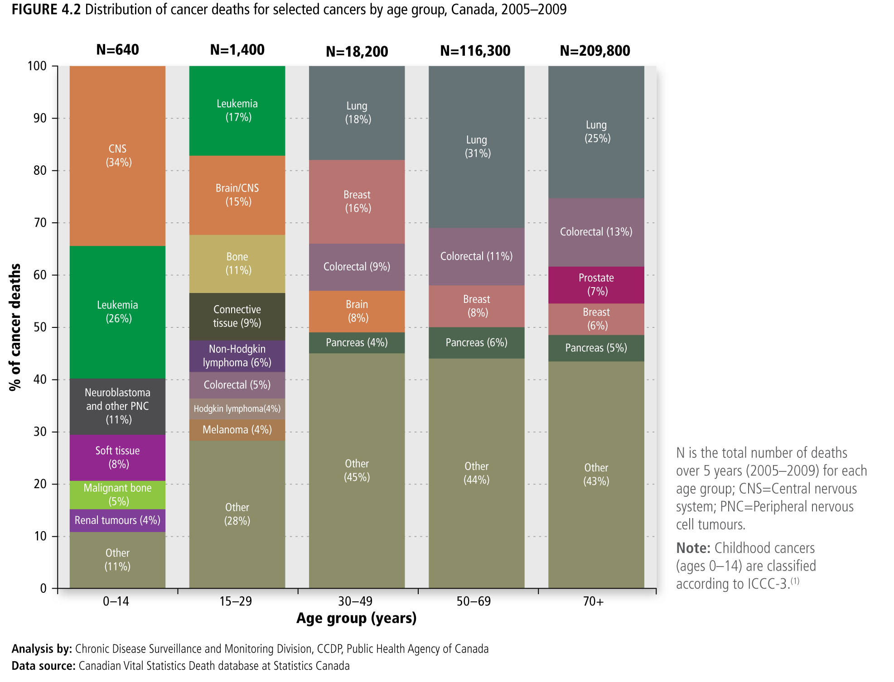
Canadian Cancer Statistics 2014

Slide 9
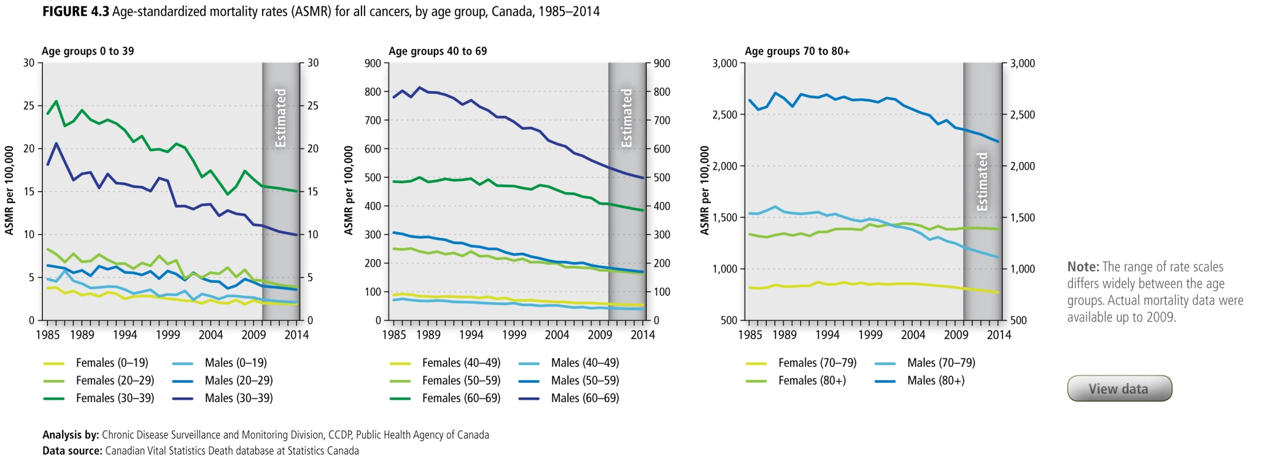
Canadian Cancer Statistics 2014

Slide 10
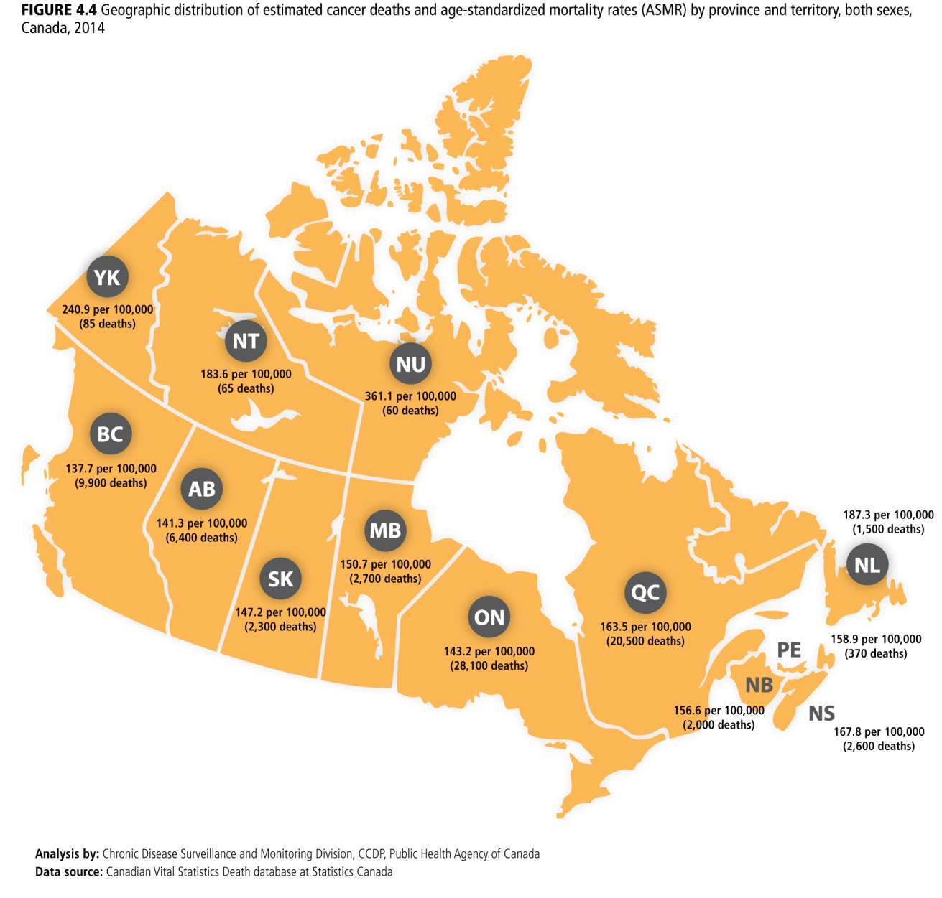
Canadian Cancer Statistics 2014

